Slide 1
Project Presentations
COMP 523
27 August 2012

Slide 2
Educational iPad games for blind students
Diane Brauner

Slide 3
Visual Schedules for Adults with Autism Add Activities to Hark the Sound
Gary Bishop

Slide 4
Teletutor: a Public Domain Remote Teaching Aide
Bill Hargrove

Slide 5
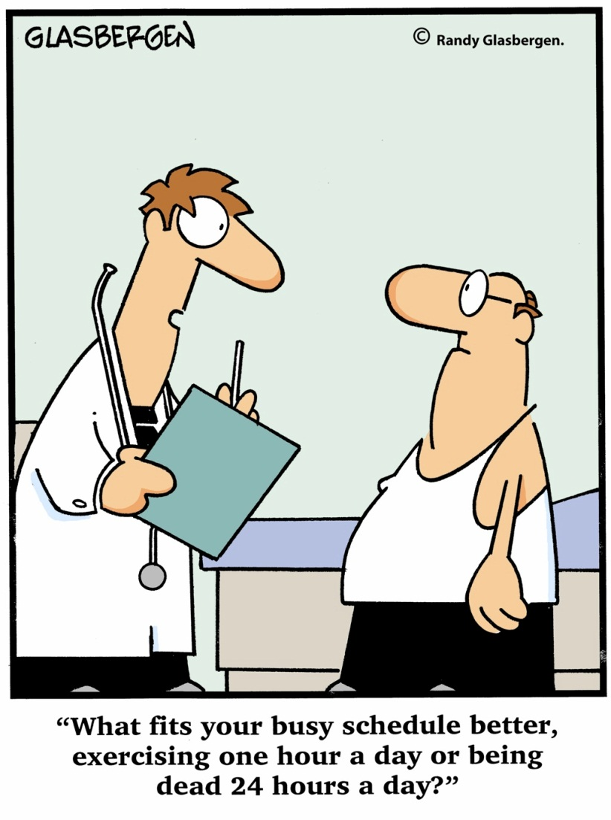
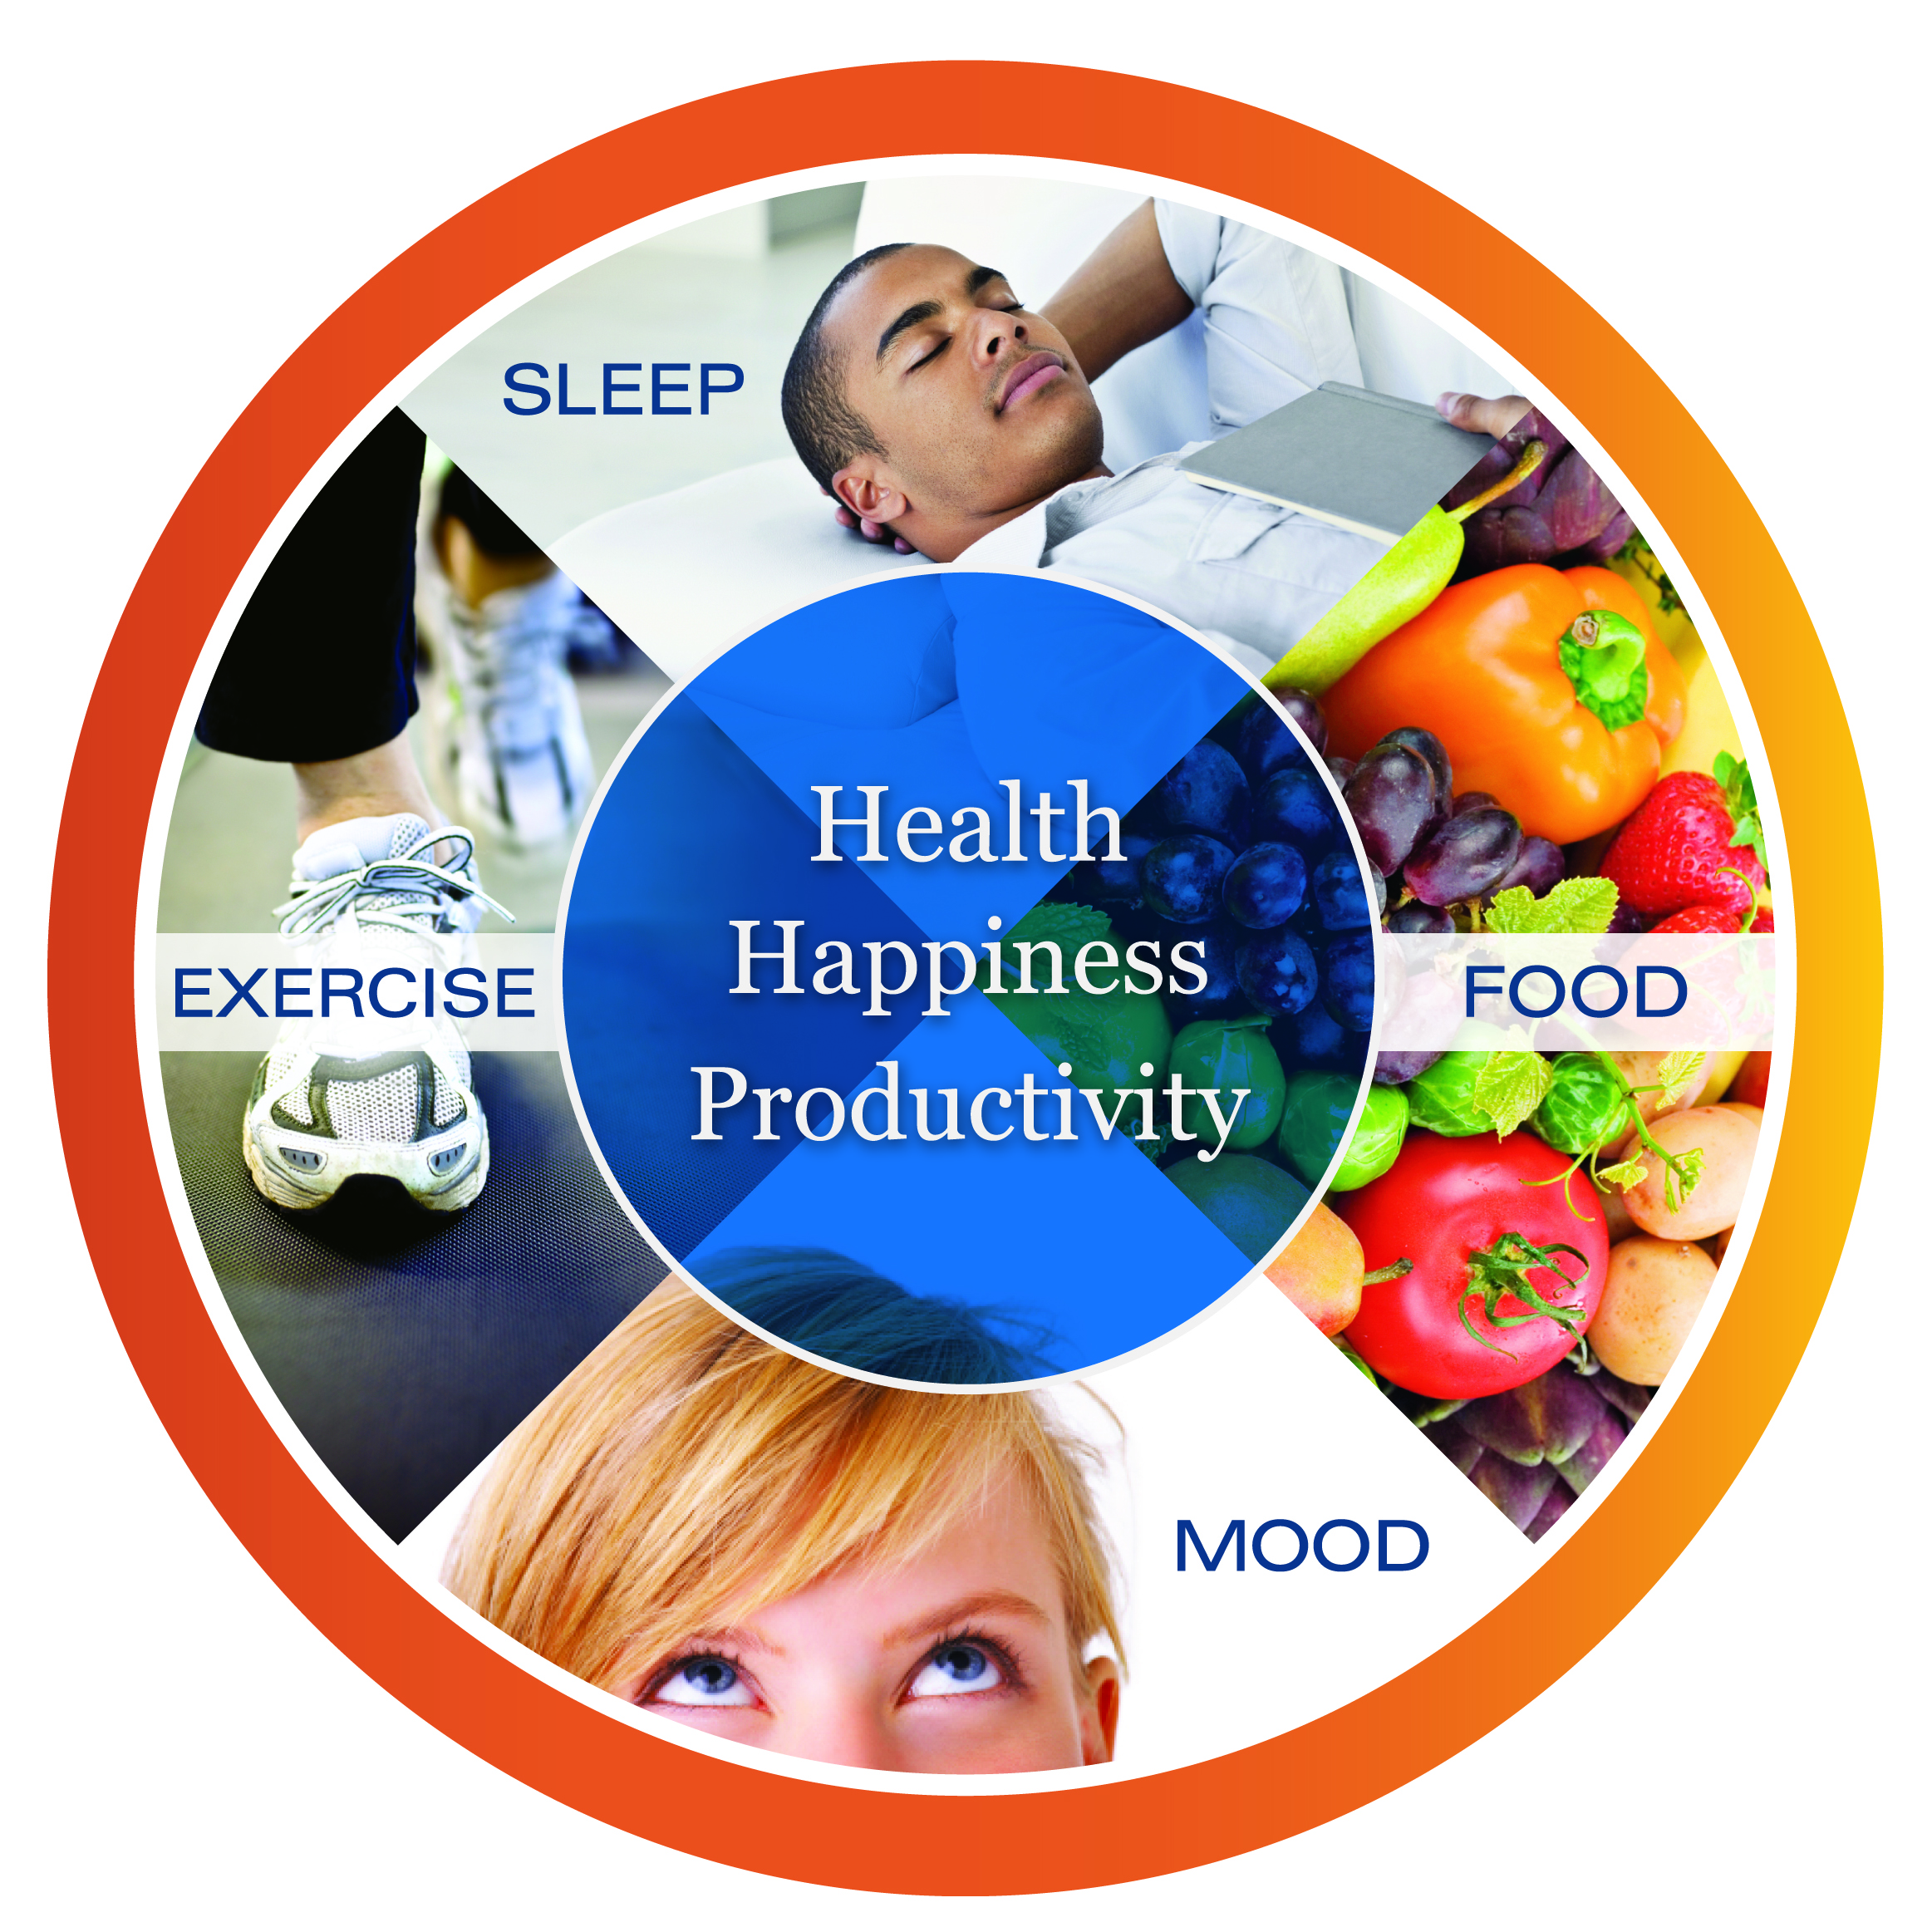
Smarts and Stamina:
A Smartphone App to Support
Healthy Living for Busy People
Marie-Josée Shaar - mj@SmartsAndStamina.com
Kathryn Britton - britton.kathryn@gmail.com

Slide 6
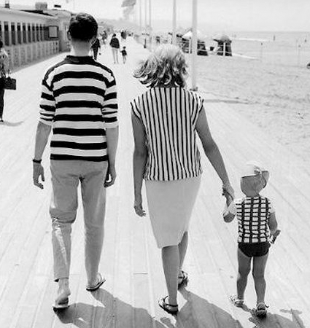
Plan B(havior)
Purpose: Portable behavioral parenting tracker and coach
Requirements:
Database – writeable, to track rewards and consequences
Database – static, with context dependent advice to improve consistency and implementation of plan
Probable language: Xcode (flexible)

Slide 7
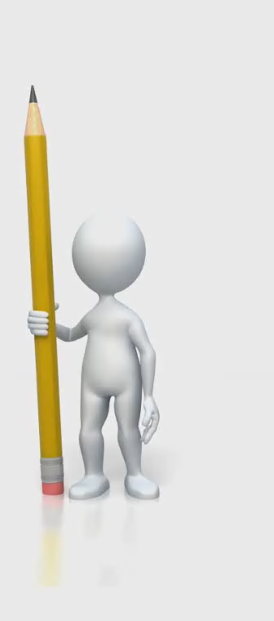

Students and Teachers Employing New Criteria in Learning
STENCIL is cloud based student information software that allows teachers to more easily manage student data.
Attendance
Behavior
Course Performance
Tools include: attendance roster, discipline log, and grade book. Software also compares data to preset high school dropout warning signs and administers an alert if student is at risk.
Low attendance
Poor Course Performance
Excessive Disciplinary Action
Apathy to Schoolwork
98,817 public and 33,366 private schools in the United States
Attrition is a NATIONAL problem
$750 million (US), $2 trillion (Global)
Successes:
-WRAL Techwire feature story (today!)
-2 pilots in January 2013
-36 invited presentations
-Carolina Launchpad class

Slide 8
Sqord additional rewards platform and virtual economy development Sqord device API integration
Coleman Greene

Slide 9
Entrepreneurial Ecosystem at UNC
seed capital at UNC
entering competitions
workshops for start-ups
classes on entrepreneurship
pro-bono services on campus
co-working spaces
networking events
speaker events
entrepreneurial student-led clubs
online resources/e-learning
research on entrepreneurship
Mathilde Verdier

Slide 10
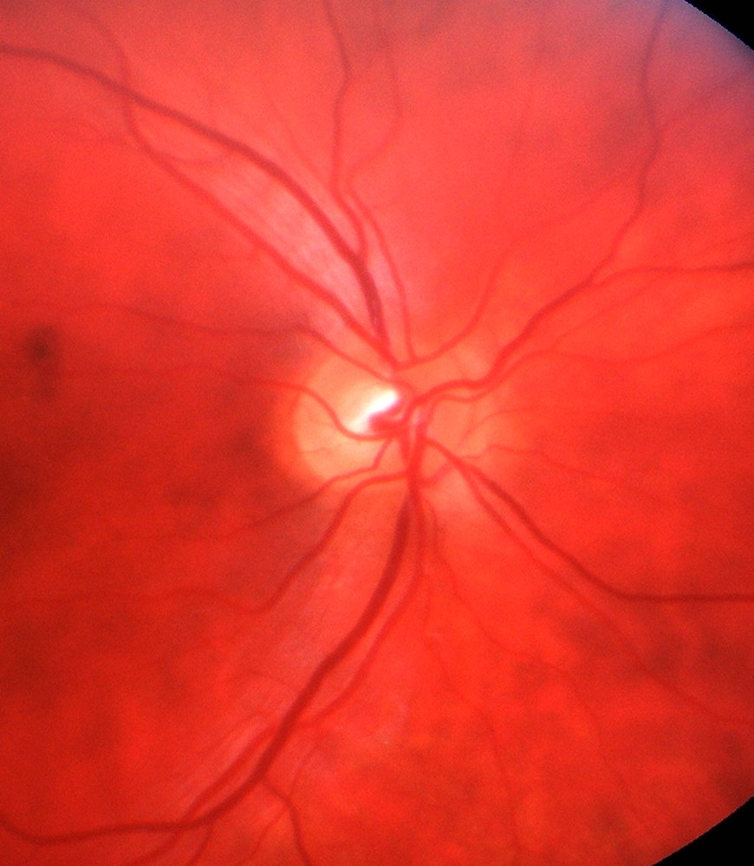
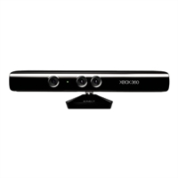
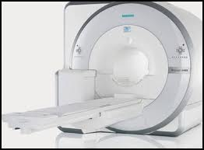
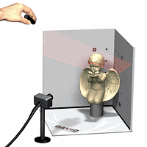
Yueh “Ray” Lee, MD/PhD, Dept of Radiology & Physics and Astronomy
leey@med.unc.edu
Project #1 – 3-D Contour Imaging for PET/MR
4th PET/MR installed in the US
Need improved attenuation correction
Arms are often missed
Use Kinect / Laserscan to acquire 3-D contour of the body
Project #2: Retinal Vessel Analysis
Current analysis in ImageJ
Need more automated approach, faster
In preparation for clinical trials

Slide 11
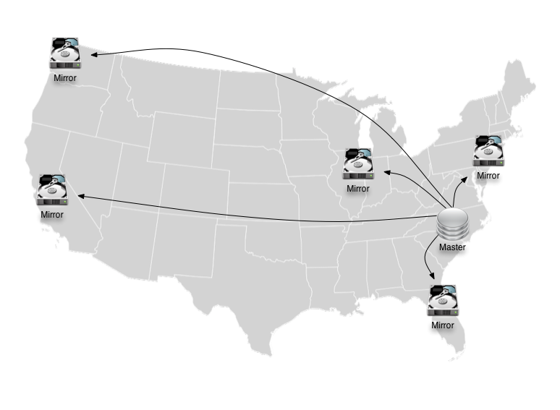
Data replication using BitTorrent
Most common: rsync
Eclipse: 250 GB, 550K files
Maven: 550 GB, 5.7M files
Ubuntu Linux: 600 GB, 600K files
Fedora Linux: 1.2 TB, 1M files

Slide 12
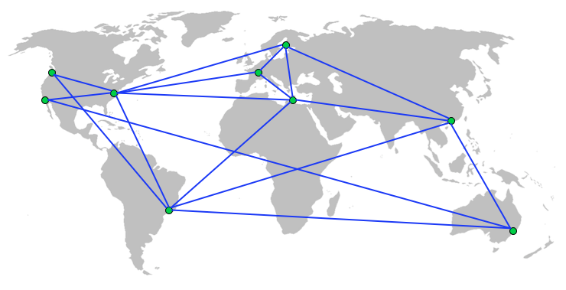
BitTorrent network testing
Test object transfers
Metrics
Speed
Interruptions
Blocking
Rate limiting
Seed bank BitTorrent server (C++, Python)

Slide 13
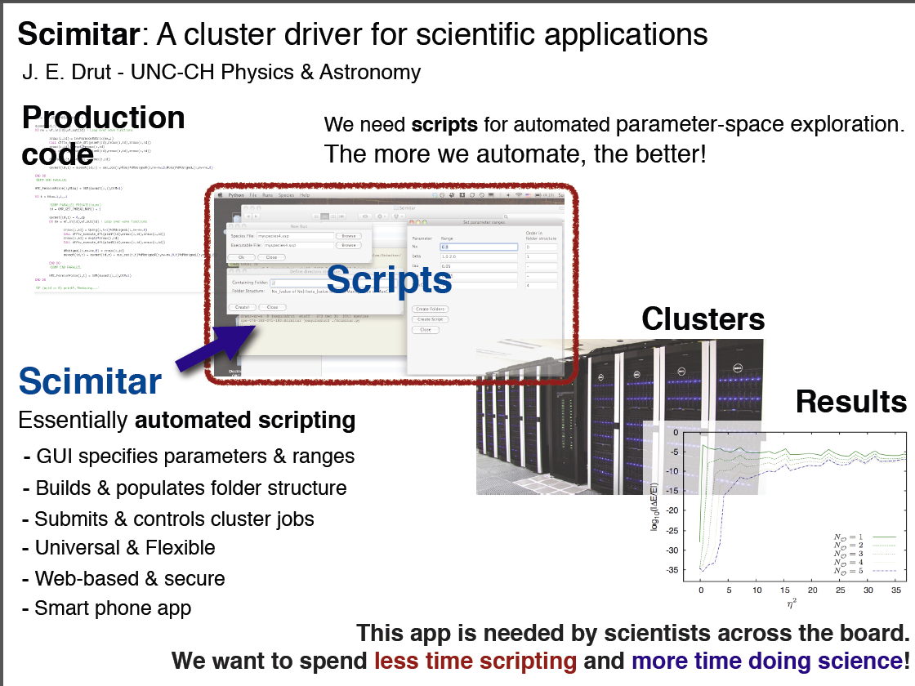

Slide 14
Create a Web API for Natural Science Data
For Brian Russell

Slide 15
Client Intake Application
Travis McCracken

Slide 16
Tripstr: Josh Middleton
Connect You With Like-minded Travelers
Mine Web Data & Match With Your Preferences
Tripstr Destination Experts
Individualized Travel Recommendations

Slide 17
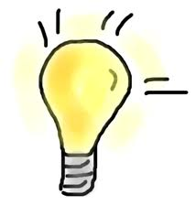

THE PAINTRACKER
You get to:
Brainstorm
Innovate on design, features,
platform
use Web Services!
and
Existing website: www.paintracking.com
?
Interactive site uses:
- PHP
- JavaScript
- MySQL (database technology)
- CSS (for styling web pages)
- amcharts (makes graphs)
?
!
work with UNC professor & author:
Deborah “Debbie” Barrett, PhD, MSW
dbarrett@unc.edu ~ (919) 843-5818
“APP” it!
Think outside
improve usability
The box
add,
adapt,
improve,
features
Web Services
Help real people track and change their experience!

Slide 18
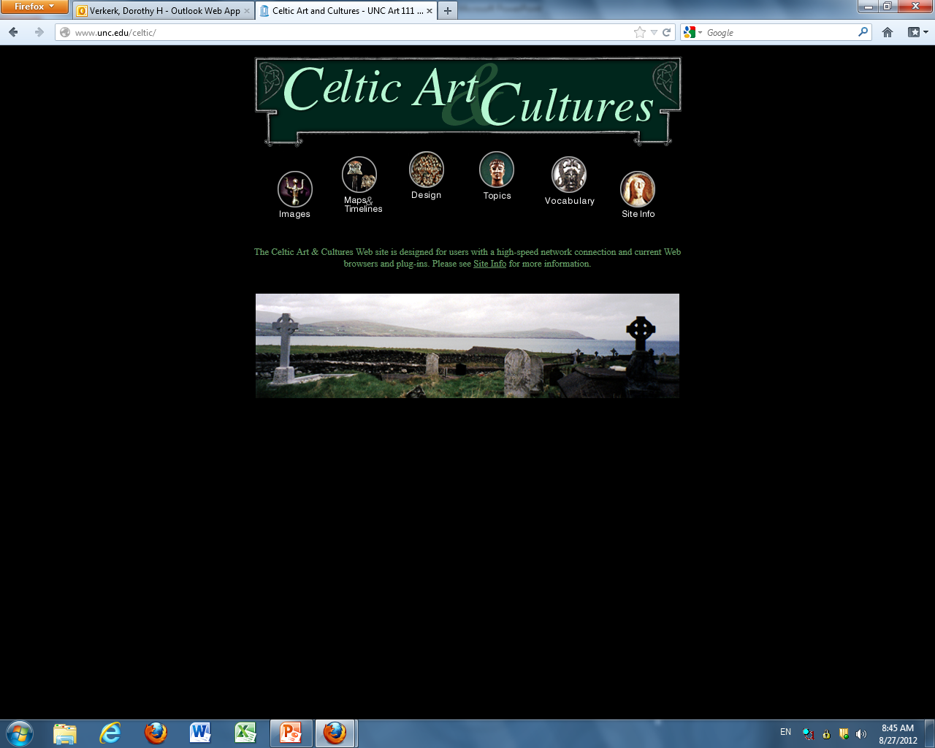

Slide 19
HistoryLab
Sarah Shields

Slide 20
Analysis of the Uncertainty in Protein Stability Data
Mohona Sarkar for Gary J. Pielak

Slide 21
Syncing Sports Broadcasts
Brian White

Slide 22
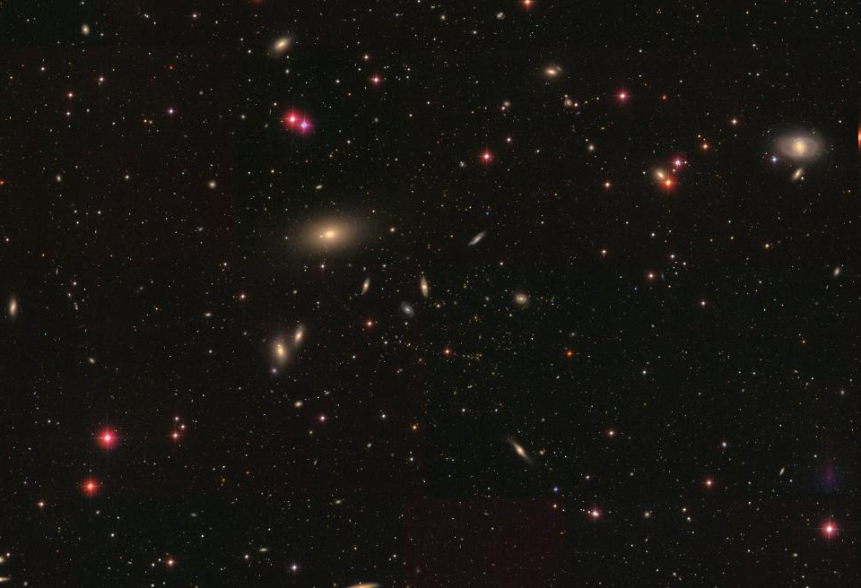
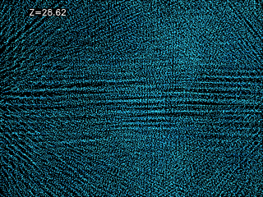

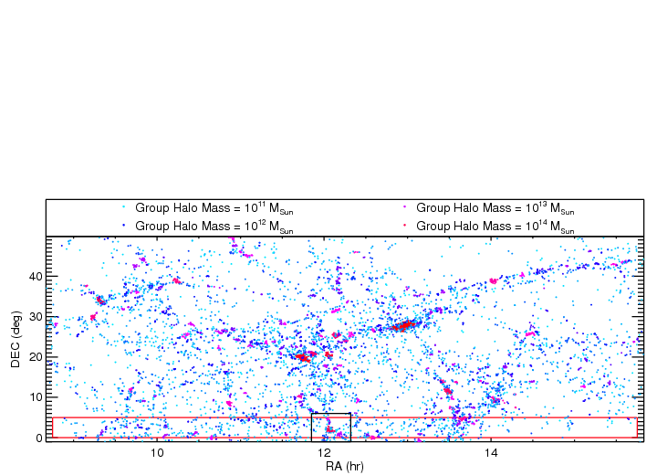
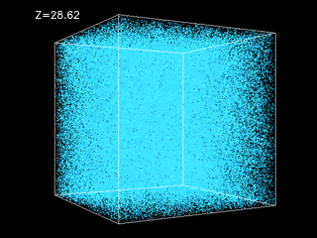
The RESOLVE Survey: A Multi-Scale Evolutionary Census of Galaxies and the Cosmic Web (Sheila Kannappan)
Sheila Kannappan
University of North Carolina Chapel Hill

Slide 23
Interactive Publication Viewer for iOS/Android Create, View and Share 3D Scenes
Patrick Reynolds

Slide 24
The Boomerang Program @ The Chapel Hill / Carrboro YMCA
Tamika Jones

Slide 25
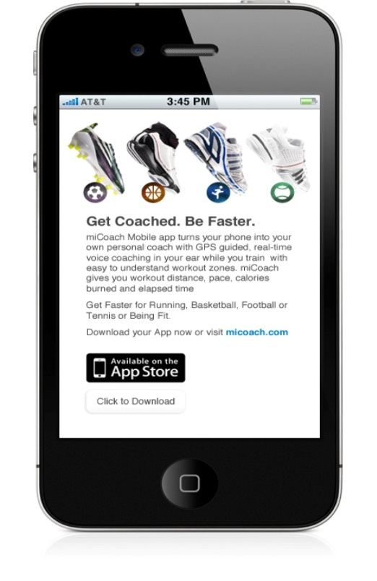
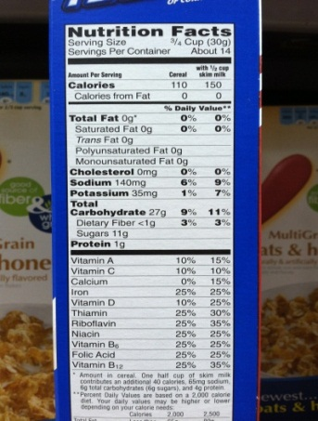
NuTRUtion: Towards the TRUth about our Food Environments
Interpreting & Organizing data
Pre-processing
OCR
Post-processing
Dynamic Database
(for researchers)
Most up-to-date Nutrition Fact Panel (NFP) data by UPC, location & date
Dynamic website & apps
Allow for comparisons across brands or products by providing NFP data per 100g
Identify errors that need to be addressed
Identify data gaps & prompt users to help collect more information
Potential game-ification to keep users engaged
Data collection via crowdsourcing
Notes:
UNCFRP
No need to buy Gladson
More knowledge about how data is collected and representativeness
Potential for commercialization??

Slide 26
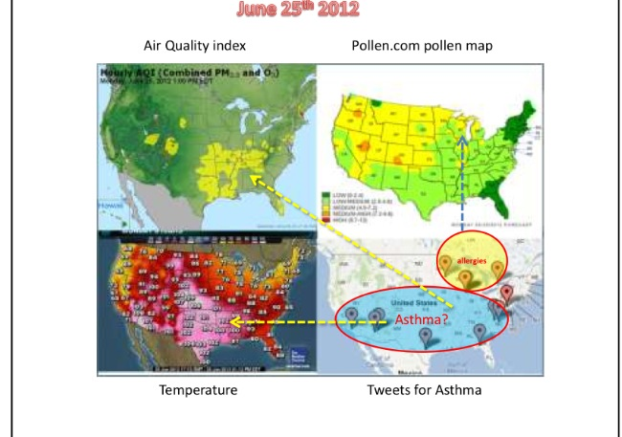
Project: PARSNIP-FA:Public Archive and Repository of Symptoms for Non-Infectious pervasive-disease factor analysis
Rocky Goldsmith

Slide 27
Ipod App
for Doug Smith

